Slide 1
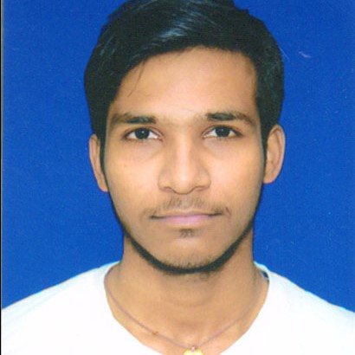

VISHAL RAY
Analyst/Software Engineer
Bachelor of Engineering
Computer Science :2017-2021
Skills
Bangalore
Java | Java Basics, OOPS, Generics, Collections, Arrays, Loops, Data Types in Java
Spring REST | Spring Fundamentals, Entity Framework Web API Routing Web API Introduction.
Spring Core | Spring core Fundamentals, Building an API with Spring MVC, Dependency Injection in Spring Core.
UI Framework-React | Fundamentals components ,Java Script, Working with states & props in React , Event Handling in React , Routing ,Life Cycle Method, Working with HTTP in React.
Angular | Components, Services, Modules, Routing, Forms & Validation, Testing using Jasmin & Karma
Database | MongoDB, basics of SQL
UI Tech | HTML 5 & CSS 3,JavaScript, Optimized UI Designed
Tools | Visual Studio 2019, Visual Studio code, Swagger, Postman
vishal.ray@capgemini.com
+91 9348512070
A4
JAVA and OOPs concepts.
Hands on experience in creating Web Application with Spring MVC , Spring Core, Web API, React.
Practical Understanding of Non-relational Database Like MongoDB.
Hands on experience in developing web pages using HTML5, CSS3, Object Oriented Programming, JSON, XML. Good understanding of Document Object Model (DOM) and DOM Functions.
Practical understanding of rendering Spring MVC Web Forms, REST API.
Angular developer with working knowledge on Angular.
Implemented Web API and React in case study and up skilling this knowledge continuously.
Airline booking Application
Working on end to end case study of Airline Booking Application along with authentication, Swagger and Angular used for user interface.
Angular and React for web developers in Degreed Platform
Completed this course with optimal Knowledge of MVC ,Web API , RESTful services , Components.
In shorts Application Clone
Developed News Application using Frontend react and Web API with MongoDB as Database .

